Slide 1
Home Learning Information Evening Rachel Wellfair-Priest, Assistant Principal (Teaching & Learning)

Slide 2
Home Learning
+5 months
Notes:
Homework | EEF (educationendowmentfoundation.org.uk)
Note – more effective at Secondary than Primary (where it is 3+ months – in case colleagues may have heard this figure instead)

Slide 3
Knowledge: How Do We Learn?
Notes:
Briefly remind of cognitive science of how we learn to provide springboard for why homework is so essential and why we need to get it right

Slide 4
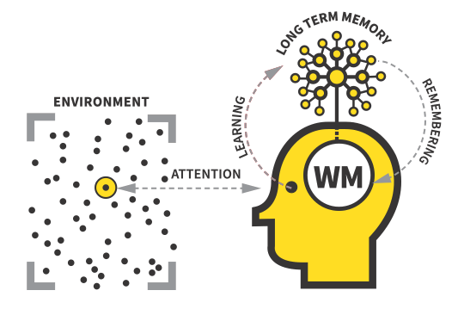
Home Learning
Notes:
Firstly there is the environment. The environment is made up of lots of stimuli that you could potentially pay attention to. It’s important that we pay attention to the right stimulus fully, as otherwise we won’t understand or remember what we are learning. That’s why it’s so important that the whole class listens carefully without talking when a teacher is explaining something new, or why we have to be silent when focussing on something really tricky; our brains cannot process information properly when they are distracted. For homework, this means finding a quiet space without social media or other distractions. So, if we pay proper attention to something, which means we focus all our attention on it without distractions, then the information can go into our working memory (WM). Working memory is quite limited; it can only process 3-4 pieces of new information at a time. That’s why learning information in short chunks rather than in a big paragraph is a good idea, and why you should learn 1-2 definitions at a time from a KO. It’s important we don’t overload our working memory, or we don’t stand a chance at ever remembering what we learn in the future. Once we have understood and processed new information, we need to practise using it. This might be through repetition, saying new words out loud or answering practice questions on a new concept. After we do this successfully, the information can be stored in our long term memory. That sounds like it should be the end of the process, but it isn’t. Because here’s the vital part; if we don’t then revisit the information at a later date, the “retrieving” part we talked about earlier, then the memory almost stays trapped in the back of our heads. Basically, it is useless to us; we would have spent effort understanding the new information, but we can’t ever actually remember it when we need it in an exam. The only way to avoid forgetting what you learn is by practising remembering it. That means, practising it not just once, not twice, but lots of times and over a long period of time. Coming back to the same knowledge again and again not just on that day, but in one week, then again in the next month, and so on. Our home learning has been designed to do this.

Slide 5
Working memory is easily over-loaded. Practice makes permanent. We also have to practice retrieving knowledge which is on the cusp of being forgotten.

Slide 6
First learned
Revised
Notes:
So as we can see, it is important to revisit information so that it is retained… BUT we don’t want to constantly revisit things too soon. In fact, a certain degree of forgetting is really useful. Having students retrieve information ‘on the cusp of being forgotten’ can be more beneficial for memory. Sarah Cottingham (Ambition Institute) – “Forgetting is like cooking a stew. Ingredients break down and combine to form better flavours. Memories also break down and details get lost, but the gist combines with other memories forming new connections. New connections = new understanding”

Slide 7
Home Learning: 4 Principles
Home learning is accessible to all students and will be clearly explained in class
Home learning should focus on practising core knowledge and skills we have taught all students
Students should receive timely feedback on their home learning
Teachers explain the value of the home learning set and the work set has a clear impact on pupil progress
Notes:
Based on research, principally from: Adam Boxer’s 4 planks and EEF research findings
Homework | EEF (educationendowmentfoundation.org.uk)
The four planks of an effective homework policy – A Chemical Orthodoxy (wordpress.com)

Slide 8
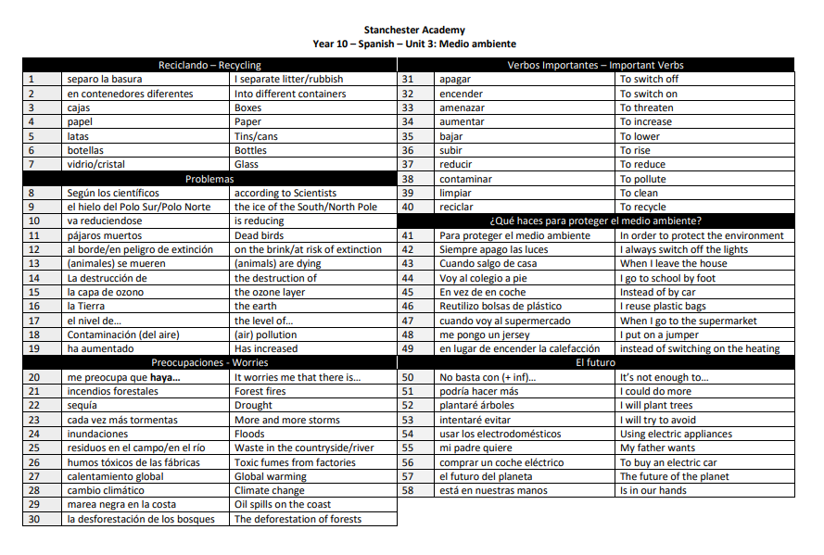
Knowledge Organisers
A4 document with all of the key knowledge you need to know fluently
Set out in a table – easier to cover.
Black and white without visual distractions – easier to focus.
Separated into clear sections
Each chunk of knowledge is numbered
Same format for every subject – cognitive load
Notes:
This is where homework and knowledge organisers come in. Our knowledge organisers have been carefully designed to help you learn and revise best. They are A4 pages with only the most essential knowledge you need to learn on. They are set out in a table – that’s because it’s easier to cover over the definitions in a table, so the “look, cover, write, check” process is much easier. They are separated into sub topics or sections, so they are easier to navigate. Each chunk of knowledge is numbered, which makes it easier and clearer when we are quizzing or setting homework. And finally, every single subject’s Knowledge Organisers look identical with hardly any pictures or colour. That is a conscious choice to limit the distractions and help you focus just on the knowledge that matters. We have worked hard to present these in a way that means you can learn and remember it the best.

Slide 9
Home Learning Policy 2022-23
What is set?
Self-quizzing – video of how to do this is on our website
Hegarty Maths
Practice exam questions (KS4)
Carousel (English)

Slide 10
Home Learning Policy 2022-23
How is it set?
Teachers have a schedule with each class for when home learning will be set and due
Clearly explained and modelled by teacher in class
Students write down what the home learning is and the date it is due in their practice books
Whole half-term of home learning is available on the website for every subject as a back up if students are absent

Slide 11
Home Learning Policy 2022-23
Organisation support
Year 7: we will print and upload centralised timetables on our website next week.
Years 8-11: students will receive a timetable they will fill in with teachers to schedule the days homework is set and due.
GCSE revision planner – Year 11 working group.

Slide 12
Home Learning Policy 2022-23
How do students receive feedback on their work?
All work receives feedback – this could be: - self; - peer; - whole-class, or; - individual
R1 (reward) point for every piece of home learning that is complete to the required standard

Slide 13
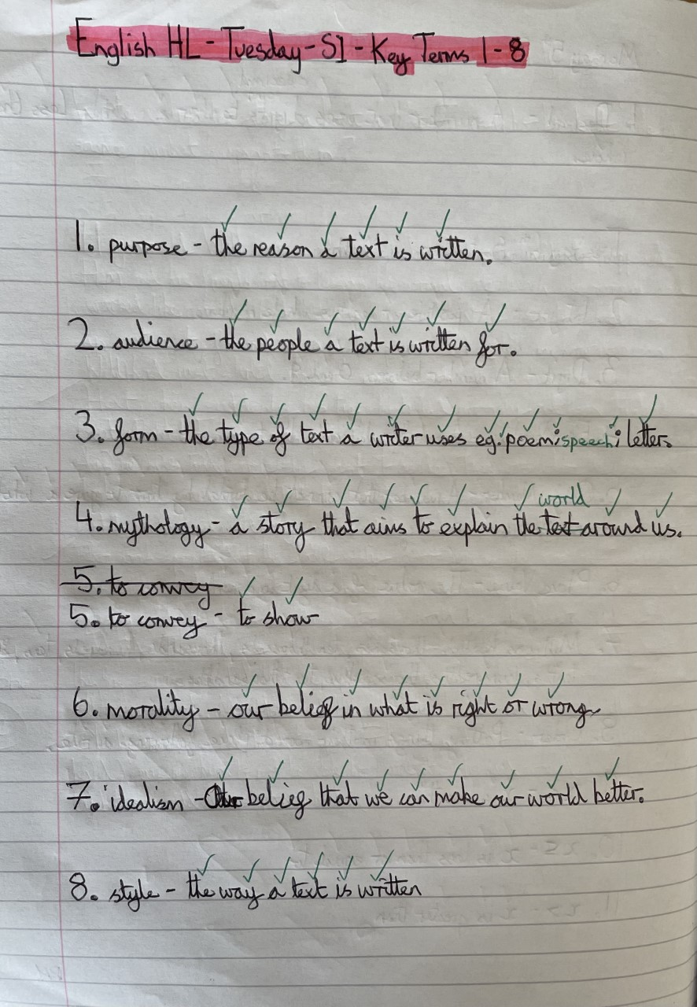
Expectations: example

Slide 14
Home Learning: Support
Learning Centre – every lunch time
E1 Maths – Wednesday lunch times M1 – Monday and Thursday lunch times Year 11: after school revision programme will be shared next week.

Slide 15
Home Learning: Non-Completion and Support
Persistent lack of HL through the Half Term
Student does not complete HL on time
Student does not meet deadline
Student misses multiple HLs
Issue persists
Persistent subject issue: Curriculum Leader meets with parents
Teacher re-explains and sets extension deadline
Teacher logs non-completion on Sims (see Sims Parent app). Invites student to HL club.
Teacher phones home to discuss. Invite to HL club to catch up
Curriculum Leader phones home to discuss and set next steps. Invite to HL club.
Persistent issue across subjects: Head of Year meets with parents

Slide 16
Supporting students to learn at home
Quiet space to work
Limit distractions
Refer to students' timetables (from next week) and the website overviews to help students get organised
"Test" or "quiz" your child on the knowledge they are learning
Check the Parent Sims App for 'R1 – Home Learning Complete' or for 'Lack of Home Learning' and have follow up conversations.

Slide 17
Get Ahead
The Get Ahead Programme - Home (mygetahead.org)
Notes:
Extra challenge opportunities – R3 points.

Slide 18
Get Ahead KS4

Slide 19
Get Ahead KS3

